Slide 1


SIT Project Review Meeting, 9 Jul 2021
KindCitizen Meal Ordering System

Slide 2
Team Members
Name | Role
Chai Min Shiung | Supervisor
Leow Zhen Zhen | Co-Supervisor
Verawaty | Co-Supervisor
Mah Ka Weng | Independent Marker
Goh Yi Xiang (191927P) | Student Developer
Heng Xu Yang (193785K) | Student Developer
Nathan Kong Yan Wei (190471J) | Student Developer
Yao Wenhui (192437T) | Student Developer

Slide 3
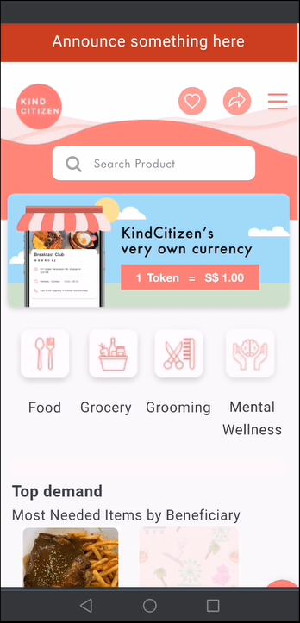
Project Objective
This project is provided by Gmeal Singapore Pte Ltd to School of Interactive & Digital Media (SIDM) and School of Information Technology (SIT) to digitize their meal ordering process involving merchants, contributors and beneficiaries.
The project will develop a total of 8 front end and backend modules to support the user stories and various workflows.

Slide 4
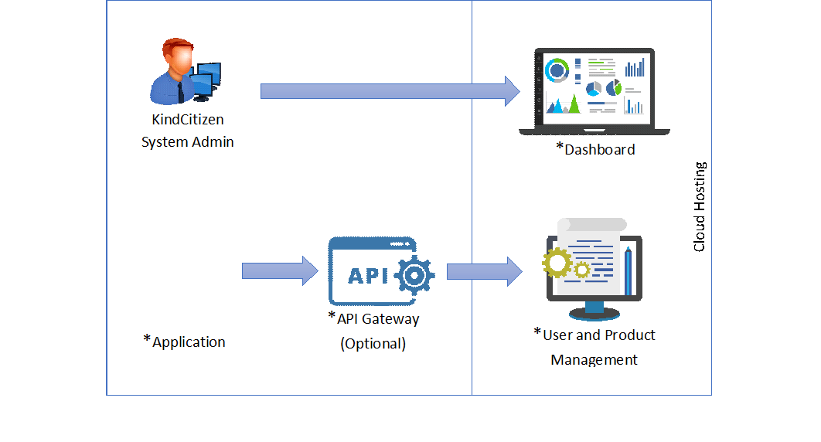
System Architecture

Slide 5
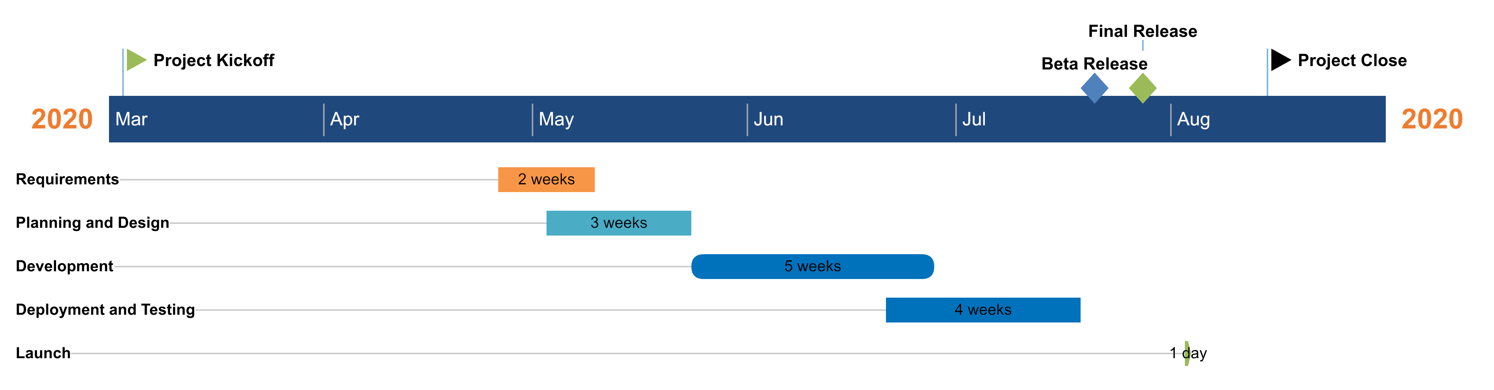
Project Timeline

